Slide 1
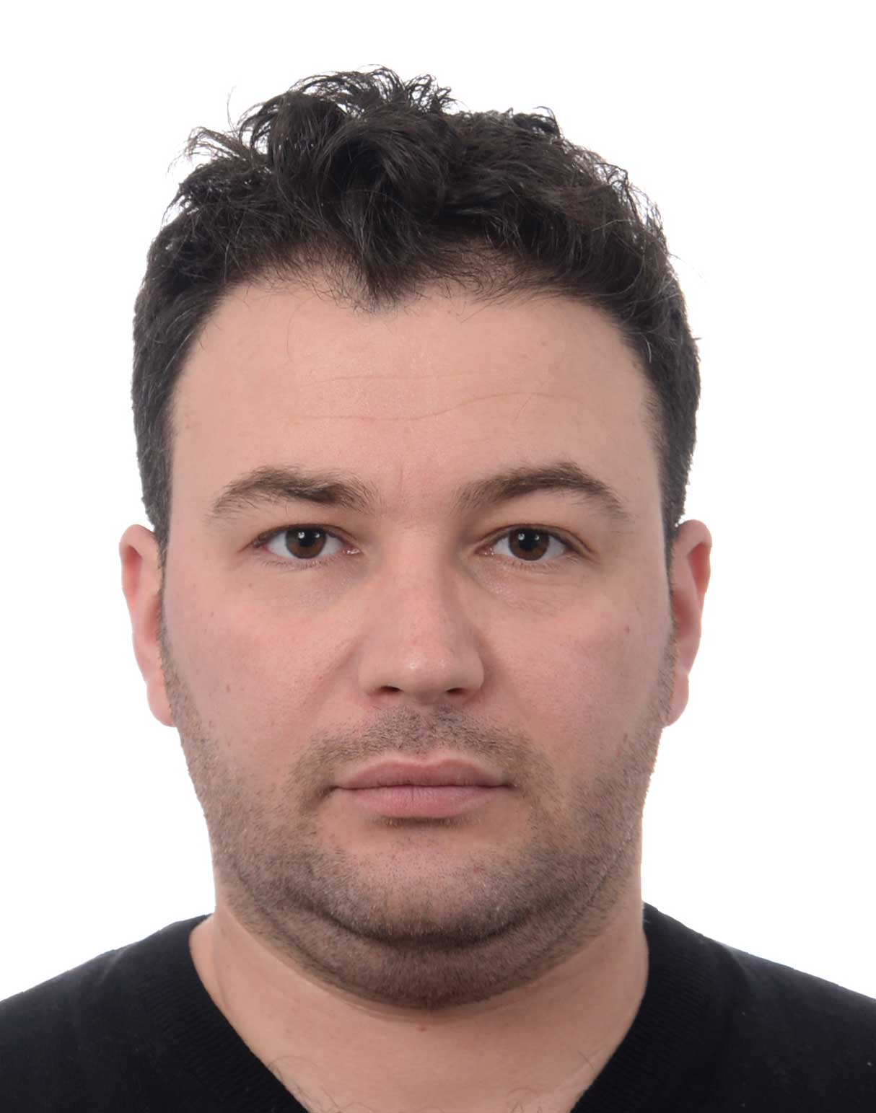

Assignment Title: Group Assignment 1
Submission Date: November 9, 2024
Course Code: COMP3095
Course Name: Web Application Development
Anar Samadzade
Student ID: 101391879
Onat Turan
Student ID: 101216227

